Slide 1
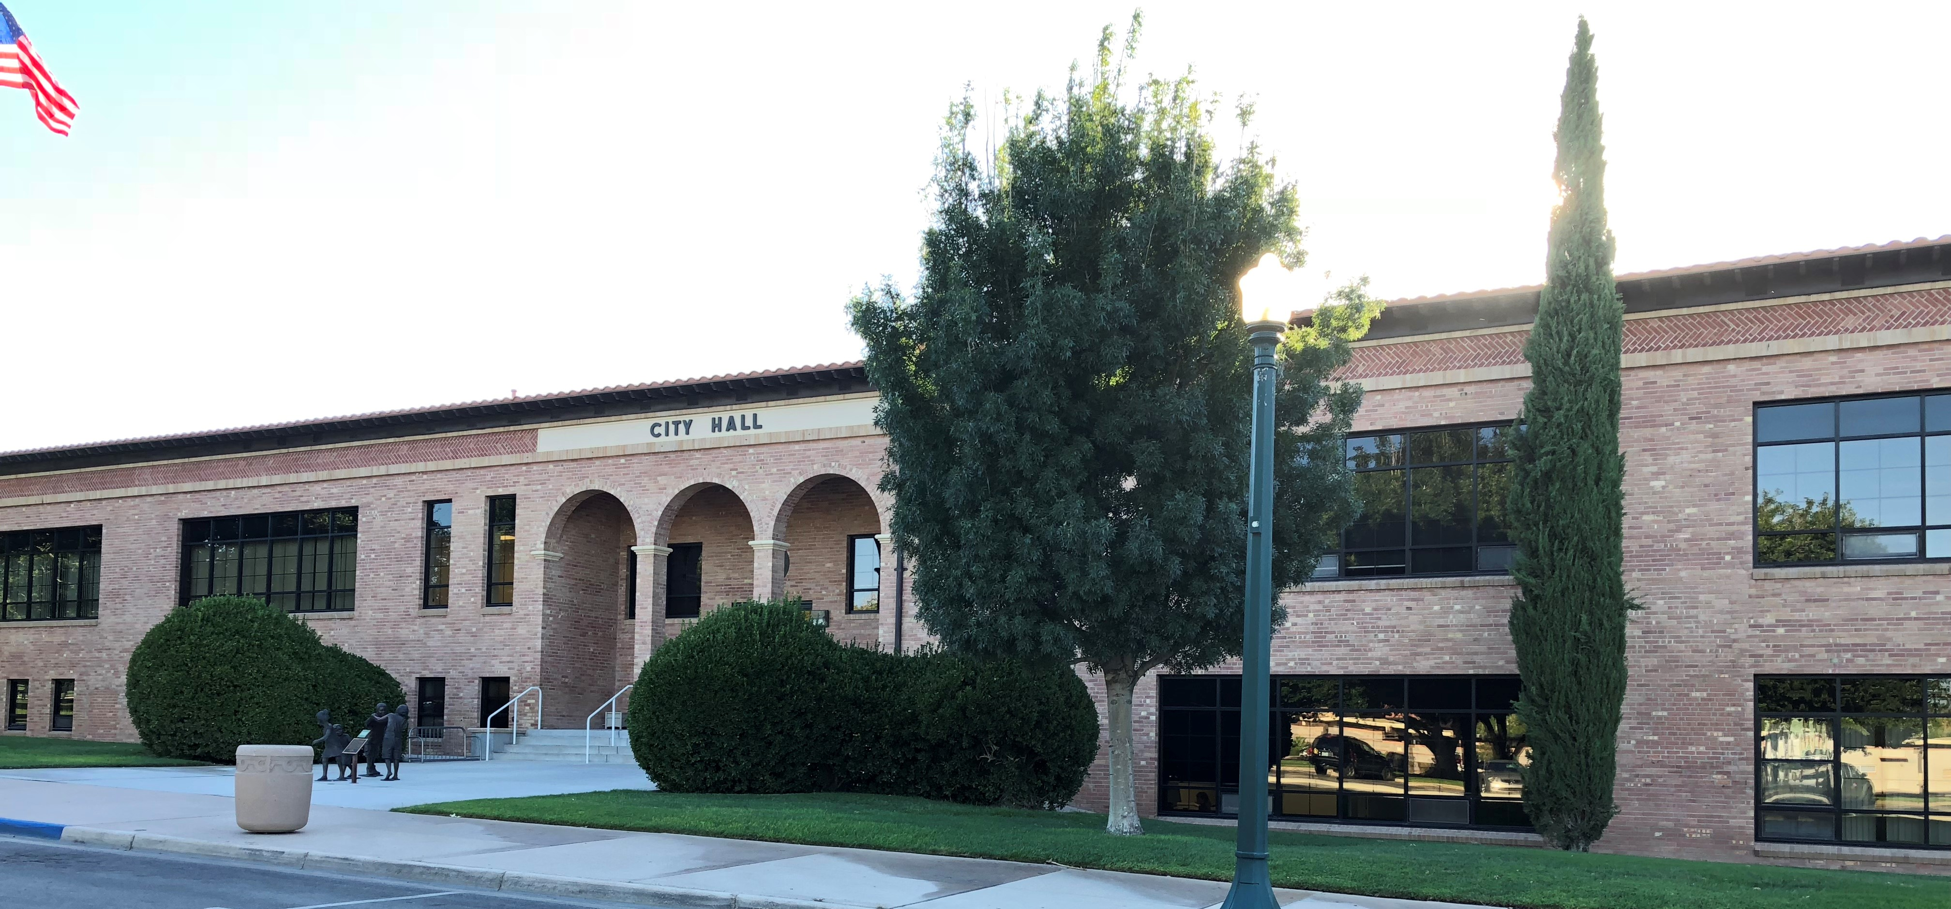
City of Boulder City
American Rescue Plan Act Funding
Recommendations – July 12, 2022
Notes:
Good afternoon. As you may recall, The American Recovery Plan Act earmarked about $21 million in funds for Boulder City. Mayor and Council asked for staff to gather input from the community on where the money should be spent. Here’s a look at the outreach, followed by the findings and staff recommendations.

Slide 2
Online Survey
News Release issued to 500+ individuals
Promoted on BCNV.org and via Social Media Platforms
TEDder Talks and Video for BCTV, social media
128 online respondents, 20 emails
65 paper submissions from Senior Center
Notes:
Survey from March 2-May 1
News Release issued to 500+ individuals
Promoted on BCNV.org and via Social Media Platforms – Facebook, Twitter, Instagram, YouTube, Nextdoor – as well as articles on FOX5, in Boulder City Review, BC Social
TEDder Talks and Video for BCTV, social media
128 online respondents, 20 emails
65 paper submissions from Senior Center of Boulder City

Slide 3
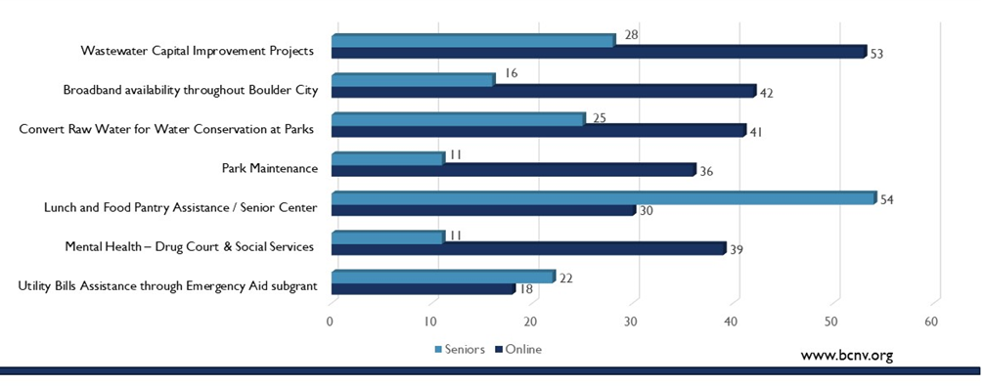
Top Infrastructure Votes
Notes:
Top Infrastructure Votes -Wastewater Capital Improvement Projects (wastewater treatment, effluent used on City Golf Courses, Parks) and convert raw water for water conservation at parks were among top picks for people who voted online, while Lunch and Food Pantry Assistance / Senior Center was a top pick for people who voted at the Senior Center. Broadband availability scored high, but unfortunately it was determined after polling started that Boulder City was not eligible for such a program.

Slide 4
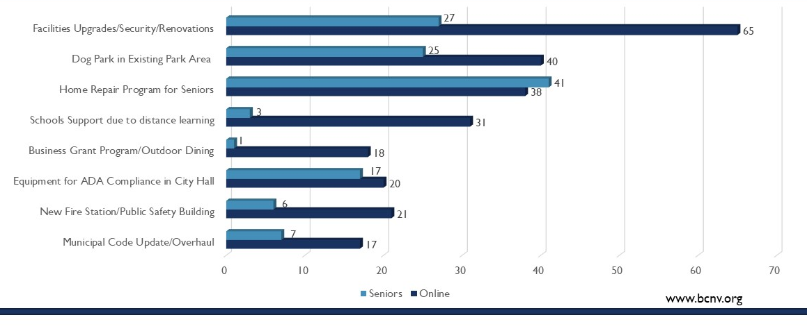
Top Fiscal Recovery Votes
Notes:
The Fiscal recovery votes aligned much closer between online voters and seniors:
Facilities Upgrades/Security/Renovations (Smith Building, PD & FD needs, City Shops, Night Skies, Signage) Dog Park in Existing Park Area Home Repair Program to improve integrity/aesthetics of properties (targeting seniors looking to age in place) all scored well. We also saw support for schools to fill gaps and prevent decline due to distance learning, Investment in Equipment for ADA Compliance in City Hall such as an elevator, hearing loop for Council Chamber, and A New Fire Substation.

Slide 5
Obligated Funds
Expenditure Purpose Obligated (Restricted) Obligated (Unrestricted) Spent to Date
Vaccine incentive raffle $10,000 $10,000
Test kits and vaccines $113,000 $12,664
PPE $20,500 $1,592
Emergency Aid assistance $50,000
Dog park improvements $72,000
Fire Department AED program $50,000
Youth sports and pool fees $175,000
Broadband for City buildings $100,000
City Clerk municipal code updates $500,000
Municipal Court unfunded mandates $300,000
Permit process improvements $80,000
Water projects $6,413,006 $735,032
Wastewater projects $3,906,531 $60,212
Total $10,613,037 $1,177,000 $819,499
Unobligated balance $1,160,753 $8,823,000
Notes:
Council approved some preliminary expenses directed at the pandemic response, including COVID test kits and vaccines, PPE and Emergency Aid assistance.
Dog park improvements, Fire Department AED program, Youth sports and pool fees, Broadband for City buildings, and City Clerk municipal code updates were also approved. Funding was set aside for Municipal Court unfunded mandates and Permit process improvements. Ten million dollars is dedicated to water and wastewater projects – very important issues as we face this historic drought.

Slide 6
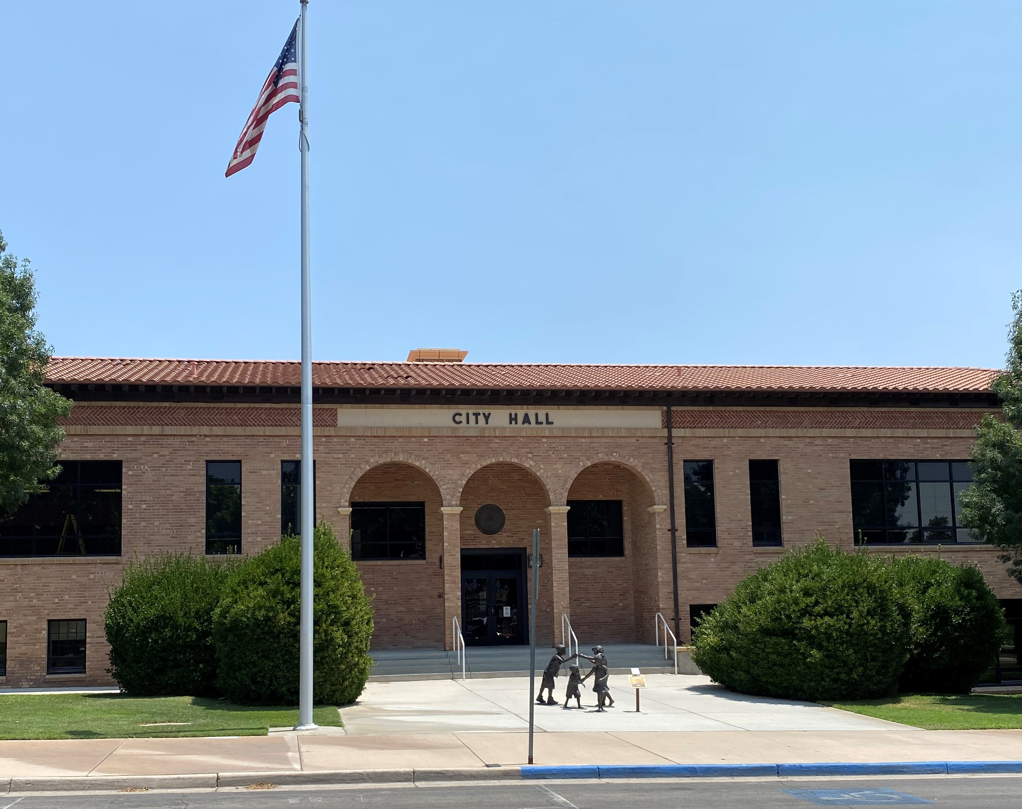
City Infrastructure
City facilities are outdated and inadequate for current staffing and technology. They lack basic security measures and are not accessible for people with disabilities. Nearly two dozen fleet vehicles need to be replaced. Staff recommends:
City Facilities/Security Upgrades $3,000,000
ADA-Compliance in City Hall $250,000
EV Vehicle Pilot Program $350,000
Notes:
City facilities are outdated and inadequate for current staffing and technology. They lack basic security measures and are not accessible for people with disabilities. Nearly two dozen fleet vehicles need to be replaced. Staff recommends $3.6 million dollars be spent on City Facilities upgrades and increased security measures at those facilities; measures to bring City Hall into compliance with the Americans with Disabilities Act, and a Electric Vehicle Pilot Program.

Slide 7
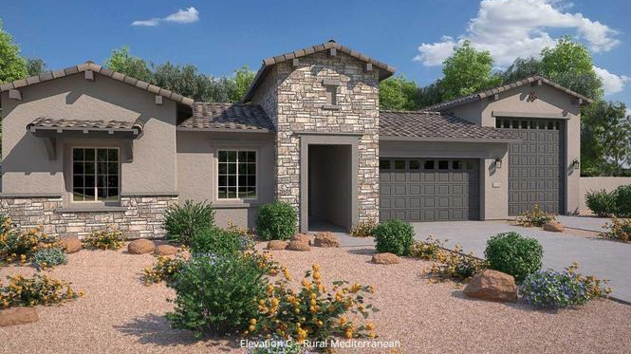
Public Safety
Forty percent of Boulder City residents live outside the nationally recognized standard of four-minute drive time from the nearest fire station. The Police Department’s non-lethal protection is outdated. Both Departments rely on effective technology for dispatch communications. Staff recommends:
Fire Department Substation $1,600,000
Police Taser Request $126,000
Mobile Field Force Equipment $65,000
Communications Gateway $150,000
Notes:
Forty percent of Boulder City residents live outside the nationally recognized standard of four-minute drive time from the nearest fire station. The Police Department’s non-lethal protection is outdated. Both Departments rely on effective technology for dispatch communications. Staff recommends 1.9 million for projects including $1.6 million for a New Fire Department Substation; Police Department Taser Request; Police Department Mobile Field Force Crowd Control Equipment for special, large scale events; and a Police and Fire Communications Gateway – dispatch equipment.

Slide 8
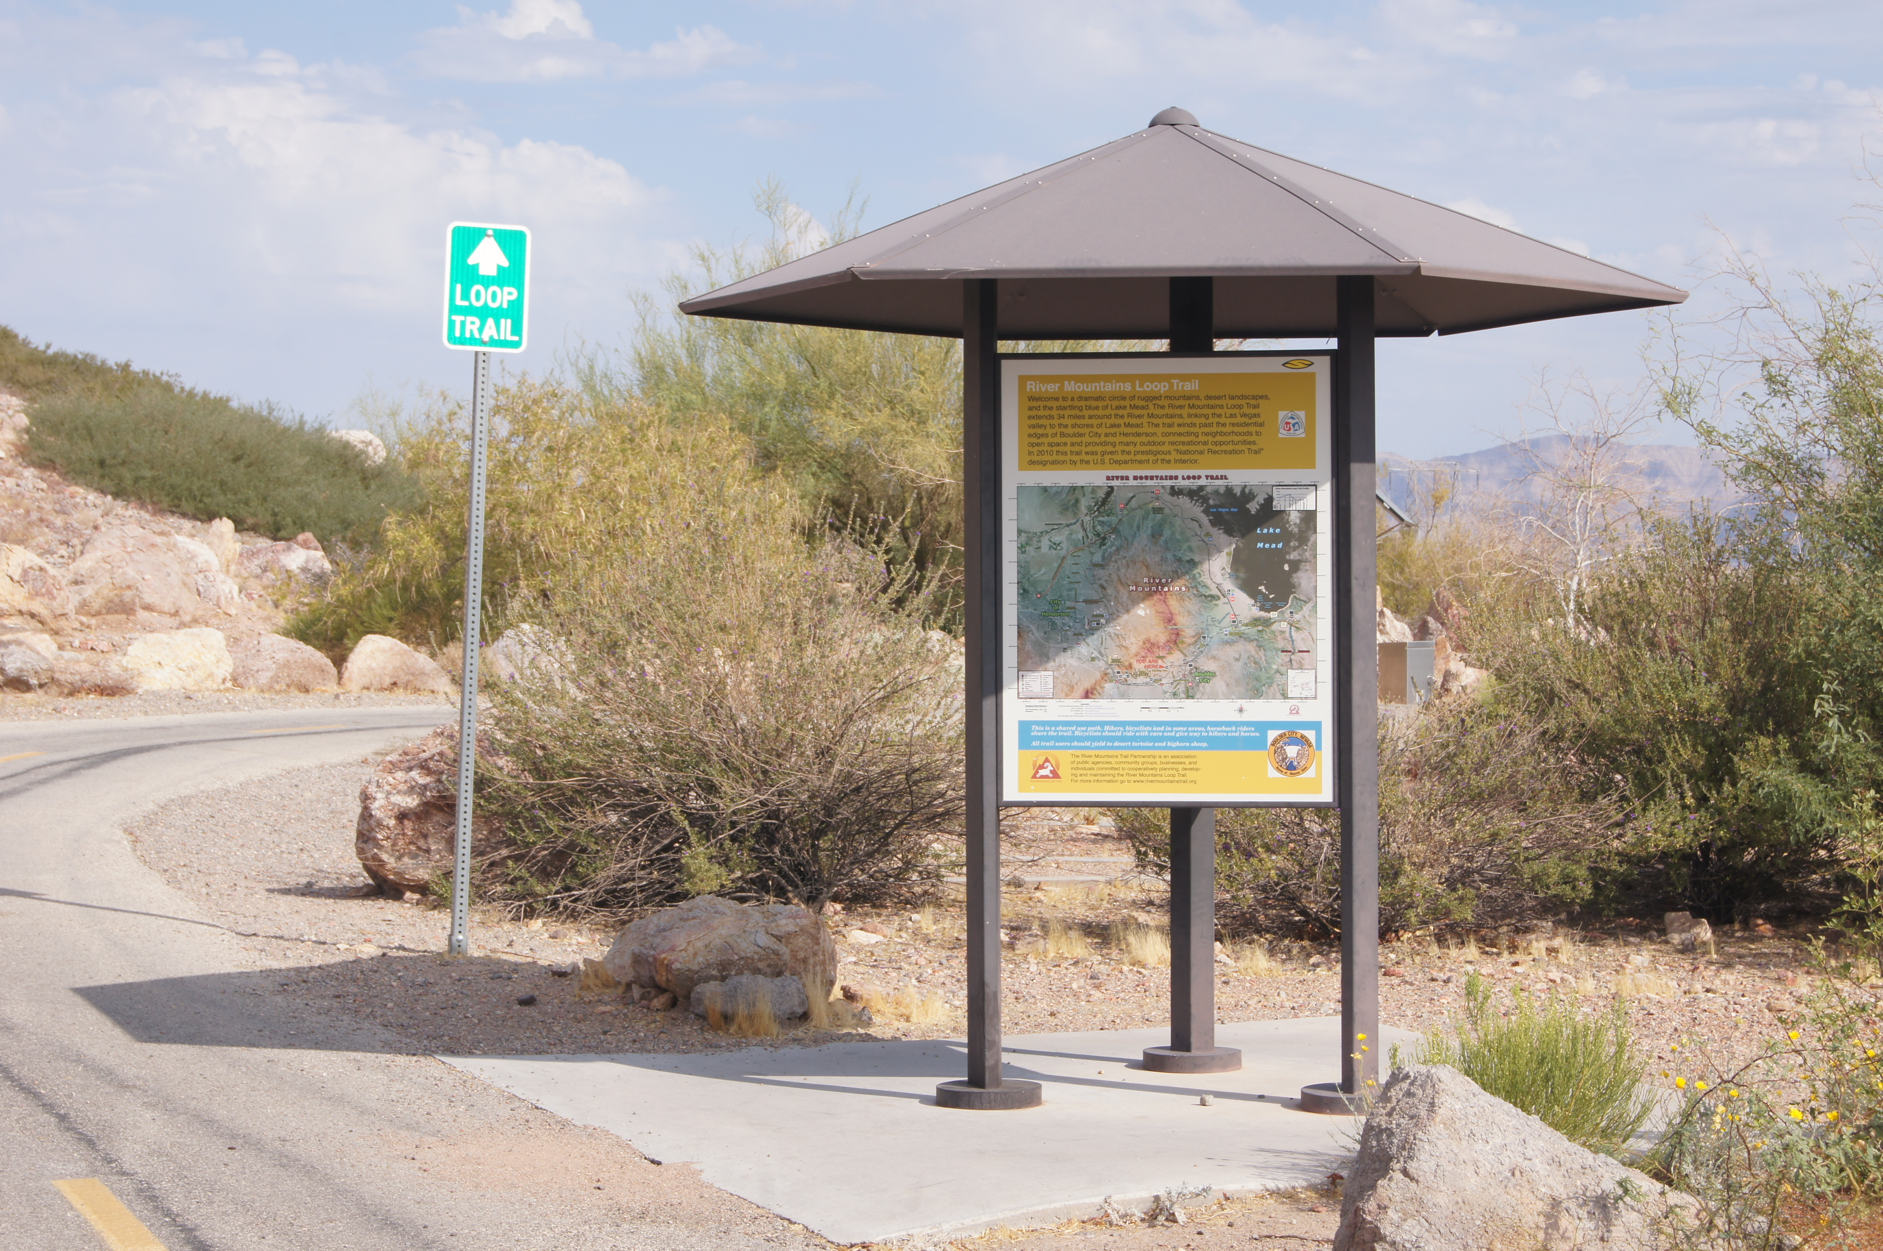
Parks, Public Works
Our streets get funds from Regional Transit Authority, but the City is responsible for alleys. We received many requests for additional Pickleball courts as well as upgrades to signage and seating in parks. Staff recommends:
Alley Maintenance $200,000
Pickleball Courts $160,000
Parks Signage and Seating $150,000
Maintenance building $50,000
Notes:
Our streets get funds from Regional Transit Authority, but the City is responsible for alleys. We received many requests for additional Pickleball courts, upgrades to signage and seating in parks and a Maintenance building for baseball the fields. Staff recommends $560,000 be spent in these areas.

Slide 9
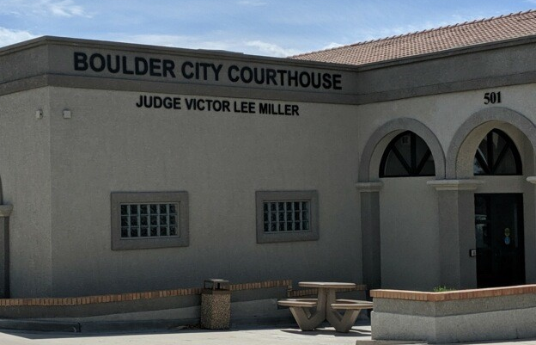
Municipal Court needs
The current courthouse is not able to accommodate social distancing in the lobby. Security measures need updating, internally and externally, including cameras and an X-ray scanner for inspection of belongings as clients enter the courthouse. Additional support for drug court is needed. Staff recommends:
Municipal Court Requests $496,000
Mental Health/Drug Court Support $200,000
Notes:
The current courthouse is not able to accommodate social distancing in the lobby. Security measures need updating, internally and externally, including cameras and an X-ray scanner for inspection of belongings as clients enter the courthouse – this was suggested during a U.S. Department of Justice Facility Audit performed in March 2021. Additional support for drug court is also requested due to increased caseload. Staff recommends nearly $700,000 for these items.

Slide 10
Unrestricted Funds
Home Repair Support Program $125,000
CCSD Boulder City School Support $100,000
Community Health Worker $400,000
Lend A Hand Request $30,000
Emergency Aid Request $330,753
See Spot Run Request $50,000
Senior Center Facility Upgrades $100,000
Senior Center Lunch & Pantry $25,000
Notes:
For unrestricted funds use, staff recommends supporting the following local aid organizations:
Home Repair Support Program
CCSD Boulder City School Support
Community Health Worker Program (BC Hospital)
Lend A Hand Grant Request
Emergency Aid Grant Request
See Spot Run Grant Request
Senior Center for Facility Upgrades as well as their lunch and pantry program

Slide 11
City of Boulder City
American Rescue Plan Act Funding
Recommendations – July 12, 2022
Thank you to our community for all suggestions and surveys.
Any questions?
Notes:
I’d like to thank all those who submitted suggestions, surveys and letters to this process, as well as those who attended the town hall. Any questions?

