Slide 1
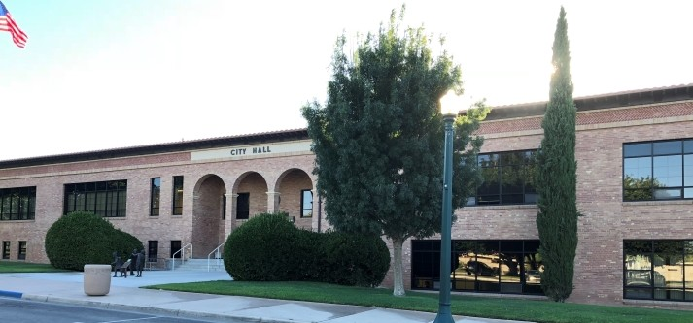
CITY OF BOULDER CITY
STRATEGIC PLAN 2025 TO 2030: IMPLEMENTATION PLAN - AUGUST 26, 2025

Slide 2
GOALS
Maintain High Quality Recreation and Tourism Offerings for Residents and Visitors – 6 Strategies
Continue Achieving Prudent Financial Stewardship – 6 Strategies
Maintain Community Character Through the Growth Control Ordinance – 6 Strategies
Continue Promoting Historic Preservation – 4 Strategies
Maintain Dependable and Reliable Infrastructure – 5 Strategies
Improve Public Health and Accessibility – 5 Strategies
Continue to Maintain High Levels of Public Safety – 7 Strategies
www.bcnv.org

Slide 3
MAINTAIN HIGH QUALITY RECREATION AND TOURISM OFFERINGS FOR RESIDENTS AND VISITORS
Strategy 1: Continue to support, plan for, and manage Boulder City’s physical recreational assets and amenities
Muni Golf Course Turf Reduction This Fall
Veterans Park Pickleball Courts Completed
Total Usage Fee, rental and other Revenue for FY25 - $6,332,898
www.bcnv.org

Slide 4
MAINTAIN HIGH QUALITY RECREATION AND TOURISM OFFERINGS FOR RESIDENTS AND VISITORS
Strategy 2: Expand Recreational Offerings With Focus on Youth:
13,936 Youth Participated In Recreation Programs in FY25
Added New Classes At Art Center
Strategy 3: Develop Permanent, Multi-purpose Meeting Spaces:
Completed Prelim. Assessment for Permanent Pavillion At Boulder Creek
Strategy 4: Complete New Pool Construction:
Selected Design Firm
www.bcnv.org

Slide 5
CONTINUE ACHIEVING PRUDENT FINANCIAL STEWARDSHIP
Strategy 1: Continue to Pursue All Grant Opportunities:
In Q4 Of FY25, the City was Awarded $4.0 Million in Grants
Strategy 2 Present a Balanced Budget to The City Council:
Balanced Budget Approved on May 27, 2025
Strategy 5 Continue to Support Non-profits and Volunteer Groups:
Council Approved $719,747 for FY26, An 11% Increase over FY25
www.bcnv.org

Slide 6
MAINTAIN COMMUNITY CHARACTER THROUGH THE GROWTH CONTROL ORDINANCE
Strategy 3: Improve Accessibility and Responsiveness of Permitting Functions
Out of 219 Surveys Received –
78.5% Rated Extremely Well And 9.9% Rated Very Well.
Strategy 4: Continue Streamlining Business Licensing Services and Processes
Utility Billing Added New Convenient Online Payment Feature
www.bcnv.org

Slide 7
MAINTAIN DEPENDABLE AND RELIABLE INFRASTRUCTURE
Strategy 1: Prioritize Use of RDA Funds in Business Thoroughfares
12kv Extension Project Completed on Nevada Way with RDA Funding
Strategy 2: Complete Objectives in Comprehensive Asset Management Plan
Received $7.8 Million in RTC Funding for Projects in FY25
Utilized $3.0 Million for Annual Maintenance in FY25
www.bcnv.org

Slide 8
IMPROVE PUBLIC HEALTH AND ACCESSIBILITY
Strategy 3: Prioritize Accessibility For Disabled Americans (ADA) Focused Investments Throughout The City
Public Works Continues to Address ADA Improvements Consistent with Recommendations by the Accessibility Working Group, including Pedestrian Safety Upgrades and City Hall ADA Access Improvements
www.bcnv.org

Slide 9
CONTINUE TO MAINTAIN HIGH LEVELS OF PUBLIC SAFETY
Strategy 1: Conduct Assessment of Current Investments, Facilities, And Equipment To Meet City’s Evolving Needs
Public Works Supporting This Goal with Current Renovation Projects at the Muni Court, Police and Fire Departments, and EOC Storage Installation
Strategy 2: Recruit And Retain Highly Trained Public Safety Staff
Fire Department Retention Rate for the Past Year Is 97%.
Police Department Retention Rate for the Past Year Is 88%
www.bcnv.org

Slide 10
WHAT’S NEXT?
City Departments will continue work on completing strategies
The City Manager will provide quarterly reports to the City Council on progress related to Plan implementation
www.bcnv.org

Slide 11

CITY OF BOULDER CITY
STRATEGIC PLAN 2025 TO 2030: IMPLEMENTATION PLAN
www.bcnv.org/stratplan
Questions?

