Slide 1
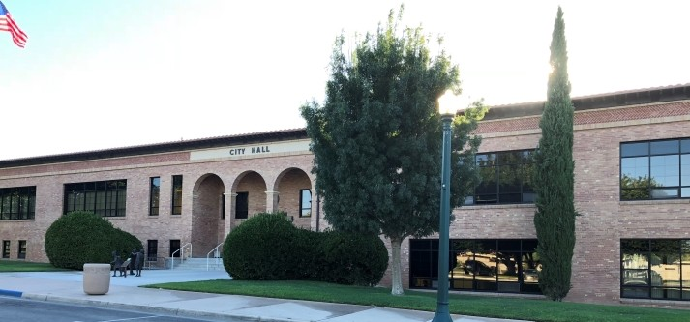
CITY OF BOULDER CITY
STRATEGIC PLAN 2025 TO 2030: IMPLEMENTATION PLAN - MAY 13, 2025

Slide 2
GOALS
Maintain High Quality Recreation and Tourism Offerings for Residents and Visitors – 6 Strategies
0%
Continue Achieving Prudent Financial Stewardship – 6 Strategies
0%
Maintain Community Character Through the Growth Control Ordinance – 6 Strategies
0%
Continue Promoting Historic Preservation – 4 Strategies
0%
Maintain Dependable and Reliable Infrastructure – 5 Strategies
0%
0%
www.bcnv.org

Slide 3
GOALS
Improve Public Health and Accessibility – 5 Strategies
0%
Continue to Maintain High Levels of Public Safety – 7 Strategies
0%
www.bcnv.org

Slide 4
MAINTAIN HIGH QUALITY RECREATION AND TOURISM OFFERINGS FOR RESIDENTS AND VISITORS
Strategy 2: Several Recreational Projects Are Underway Including:
Muni Golf Course Turf Reduction (Planning)
Veterans Park Pickleball Courts (Construction)
Del Prado Playground Renovation (Construction)
www.bcnv.org

Slide 5
MAINTAIN HIGH QUALITY RECREATION AND TOURISM OFFERINGS FOR RESIDENTS AND VISITORS
Strategy 4: Complete New Pool Construction:
Voter Approval Of 2024 Ballot Question Allows City to Begin Sooner
Staff Has Developed A Schedule For Timely Completion
Process To Select Design Consultant Underway
Completion Target Date – Early 2028
www.bcnv.org

Slide 6
CONTINUE ACHIEVING PRUDENT FINANCIAL STEWARDSHIP
Strategy 2: Conduct Annual Budgeting Processes With A Focus On Accuracy In Budgeting And Estimation
  Staff Presented A Balanced Budget To The City Council For FY26
Strategy 4 Increase Fiscal And Budgetary Transparency
Received Cashman Good Government Award
New Publication On Special Revenue Funds Created And Made Available On The Website
www.bcnv.org

Slide 7
MAINTAIN COMMUNITY CHARACTER THROUGH THE GROWTH CONTROL ORDINANCE
Strategy 1: Reduce Barriers To Achieving Diverse Housing Types, Consistent With The Growth Control Ordinance
Working With Consultant, LWC To Update Title 11
Strategy 4: Continue Streamlining Business Licensing Services And Associated Processes
Fire, Public Works, Utilities, Community Development Meet Quarterly To Discuss Customer Service Improvements
Private Project Review Meetings With Applicants
www.bcnv.org

Slide 8
CONTINUE PROMOTING HISTORIC PRESERVATION
Strategy 4: Increase Awareness Of The Economic Benefits Of Historic Preservation For The City
November Letter To All Historic District Property Owners
BC Insider About Historic Preservation
April Realtor Workshop On Historic Preservation
www.bcnv.org

Slide 9
MAINTAIN DEPENDABLE AND RELIABLE INFRASTRUCTURE
Strategy 2: Perform Biannual Reviews Of The Comprehensive Asset Management Plan (CAMP) For All City Infrastructure
Integrating The Pavement Management System To Map Out Upcoming Roadway Maintenance Project
Strategy 4: Pursue public infrastructure projects to support infill/ redevelopment throughout the city
Many Projects Underway: 12kV Extension Project, Nevada Way Rehabilitation, Water Service Replacements
www.bcnv.org

Slide 10
IMPROVE PUBLIC HEALTH AND ACCESSIBILITY
Strategy 3: Prioritize Accessibility For Disabled Americans (ADA) Focused Investments Throughout The City
Public Works Continues To Work On ADA Improvements That Follow The Accessibility Working Group Recommendations Including Pedestrian Safety Upgrades And City Hall ADA Access Improvements
www.bcnv.org

Slide 11
CONTINUE TO MAINTAIN HIGH LEVELS OF PUBLIC SAFETY
Strategy 2: Recruit And Retain Highly Trained Public Safety Staff
Fire Department Started The New Reserve Academy On March 8, 2025
Strategy 4: Define And Disseminate Standards To Ensure A High Level Of Public Safety Services
Police Department Conducted An Assessment And Cost Model For The Only Accreditation Available For Nevada Agencies And Submitted For Consideration
www.bcnv.org

Slide 12
WHAT’S NEXT?
Continue to work on completing strategies
The City Manager will provide quarterly reports to the City Council on the progress of the plan's implementation
www.bcnv.org

Slide 13

CITY OF BOULDER CITY
STRATEGIC PLAN 2025 TO 2030: IMPLEMENTATION PLAN – MAY 13, 2025
www.bcnv.org/stratplan
Questions?

