Slide 1
Boulder City Municipal Airport Ground Vehicle Operator Training

Slide 2
Purpose of this training
…to educate & establish guidelines and assign responsibility for the safe operation of vehicles within the airport movement area (AMA)
…to provide an overview of the handbook and provide you the necessary knowledge to drive in the AMA

Slide 3
Why?
FAA States:
…responsibility rests with the airport operator to establish procedures and policies concerning vehicle access on airport.
…keep vehicular and pedestrian activity on the airside of the airport to a minimum…limited to those vehicles necessary to support the operation of aircraft services and maintenance of the airport.

Slide 4
Outcome
After Viewing this presentation
Review for the Test
Pass the 20 question test regarding Procedures at BVU (questions from the presentation and the handbook)
You will get a badge indicating you are a “D”river and are authorized by airport management to drive in the Airport Movement Area AMA – Restricted from crossing or proceeding onto any Runways

Slide 5
Topics covered
Airport Terminology
Airport Layout
Vehicle Operations
Situational Awareness
Airport Markings and Signage
Radio Communications
Review Airport HOT SPOTS
Airport Safety

Slide 6
Terminology
Concepts and terminology you should be familiar with…

Slide 7
Airside
…within the fence
taxiways, runways, ramps, perimeter road, taxilanes, buildings, safety areas

Slide 8
Hot Spot
A location on an Airport Movement Area with a history of potential risk of collision or runway incursion, and where heightened attention by pilots and drivers is necessary.

Slide 9
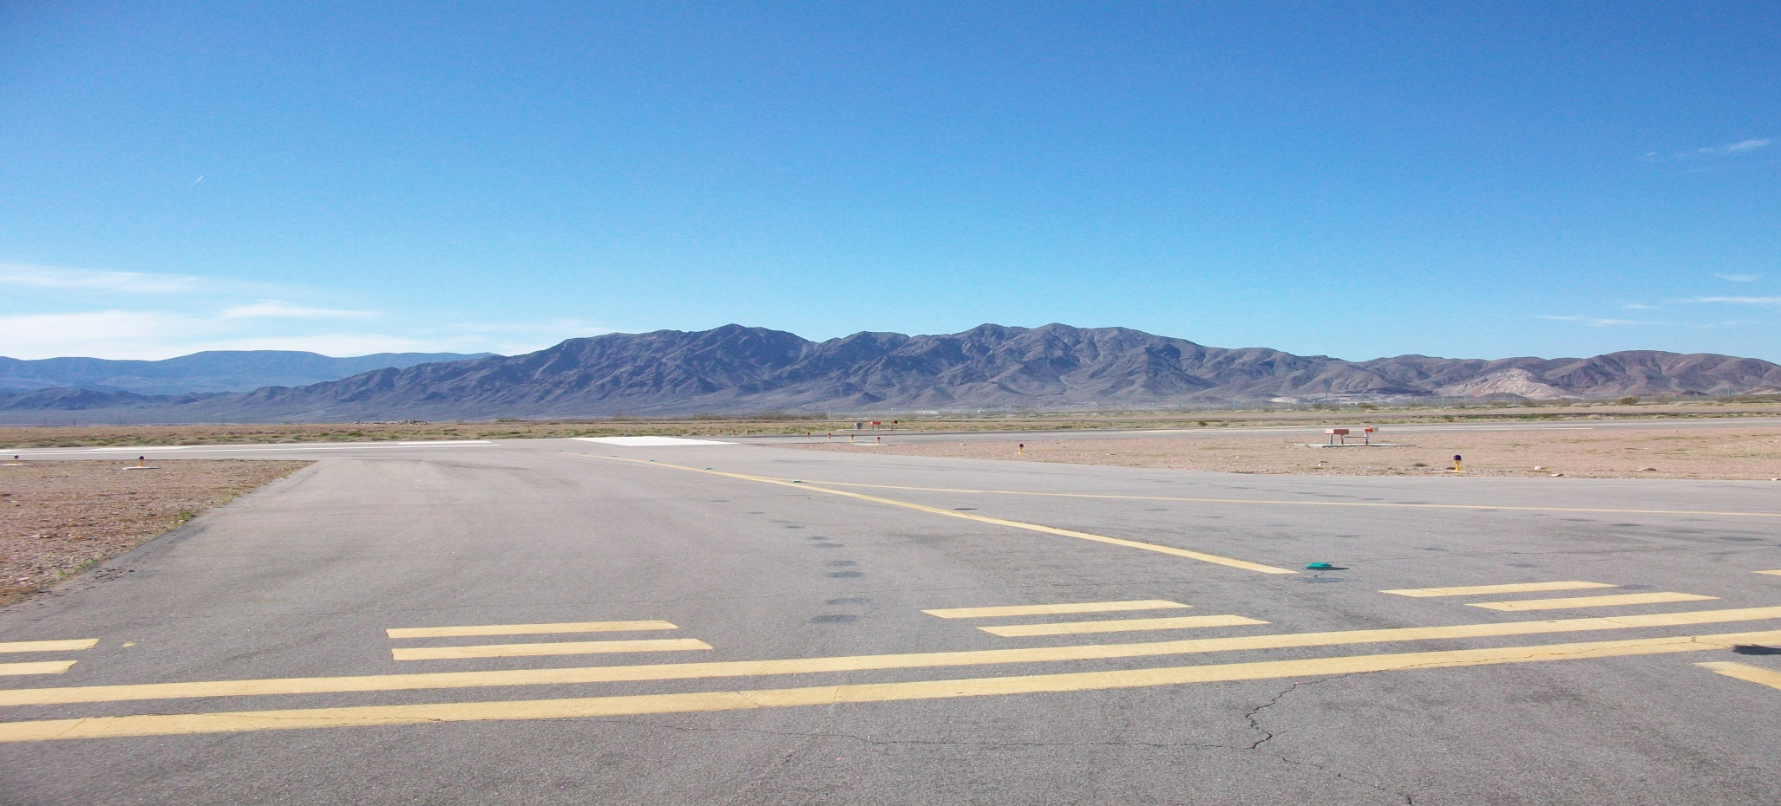
Airport Movement Area
areas used for takeoff, landing, taxing, and hovering of aircraft
Taxiway Delta holding short Runway 15

Slide 10
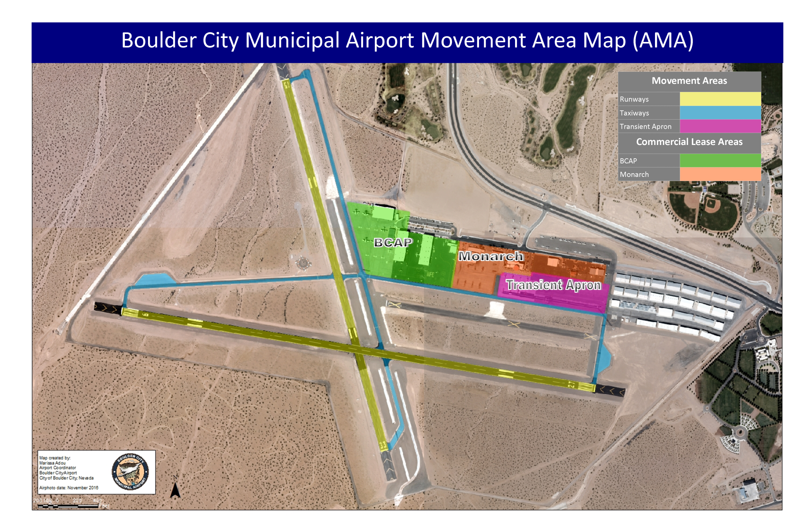
Airport Movement Areas

Slide 11
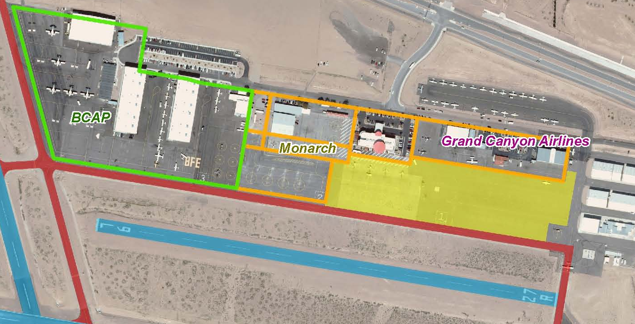
Ramp Area
…accommodate aircraft for the purposes of parking, loading and unloading of passengers or cargo, refueling, or maintenance.
All companies on the airport each have their own ramp areas, and some may operate from the City’s Transient Ramp.

Slide 12
Airport Basics
Runways
Taxiways

Slide 13
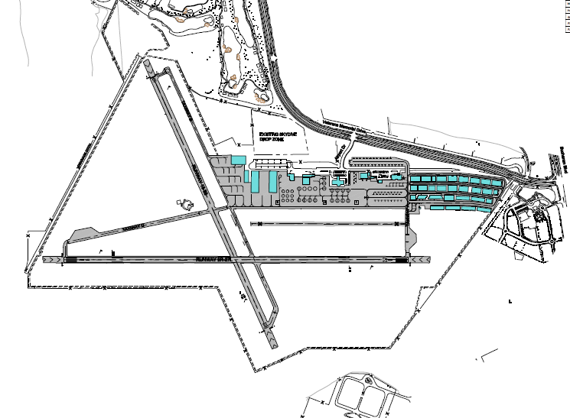
Runway Layout
15
x
x
9
27
33

Slide 14
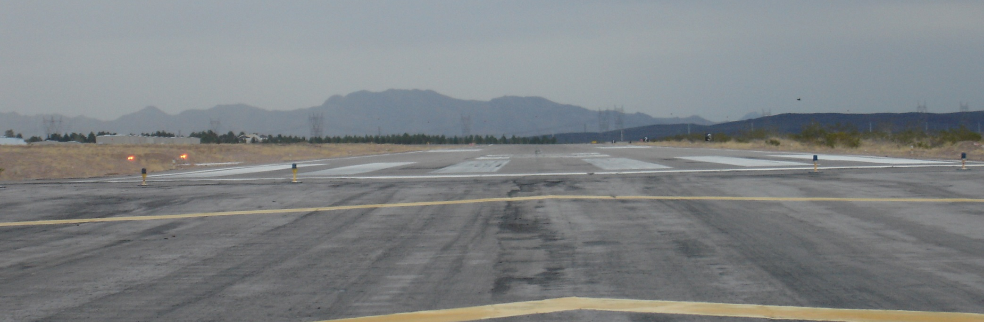
Runways - defined
Purpose to allow aircraft to take-off and land

Slide 15
Runways - Markings
All pavement markings are White
Runway Designator
Centerline
9
Threshold
Edge

Slide 16
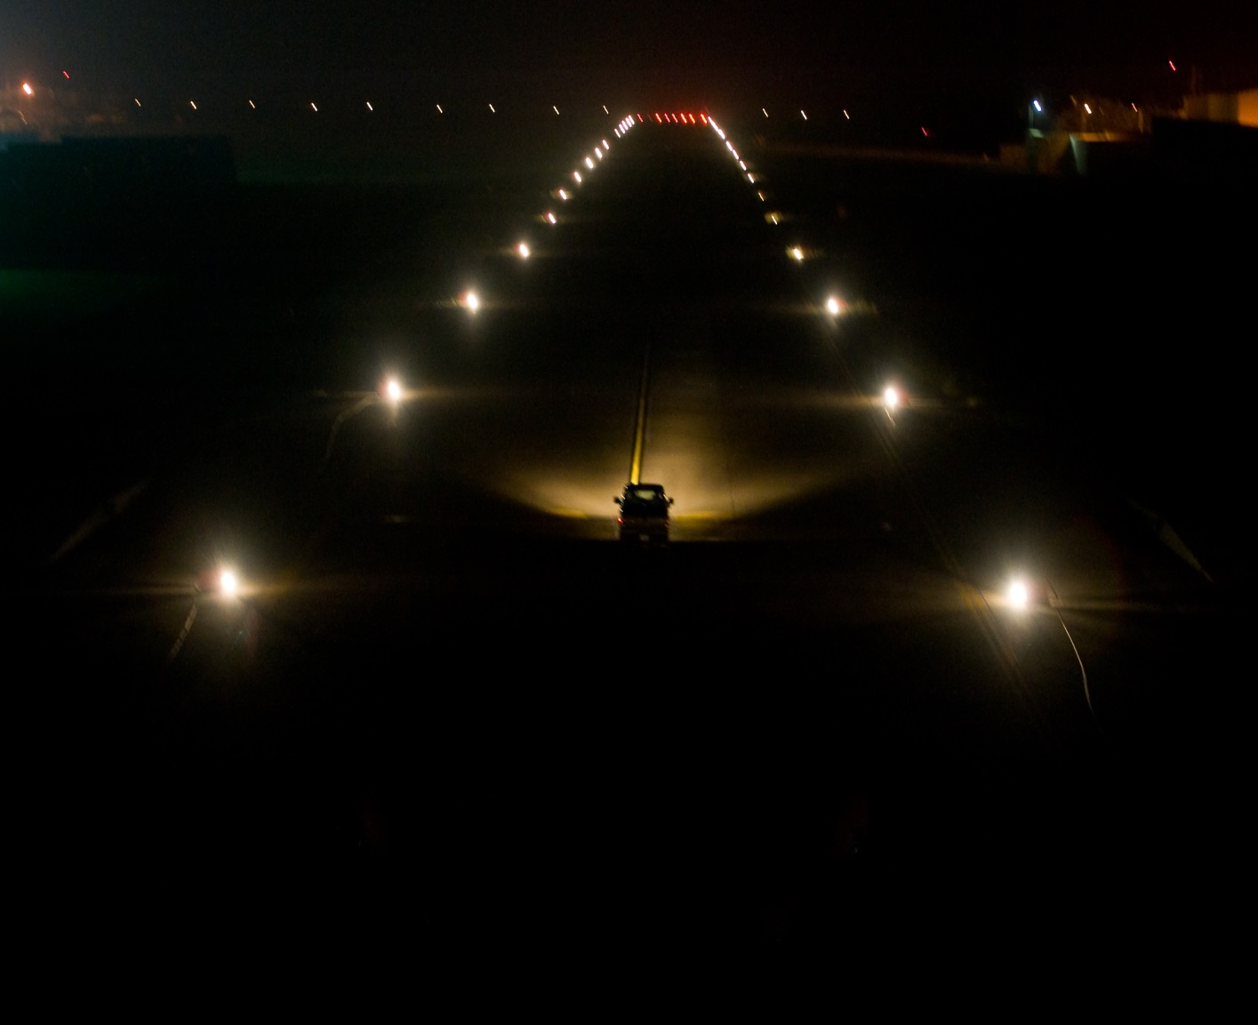

Runways - lighting
White runway edge lights are white

Slide 17
Runways – lighting
Runway threshold lights
Two-sided: Red/Green
Runway End/Beginning

Slide 18
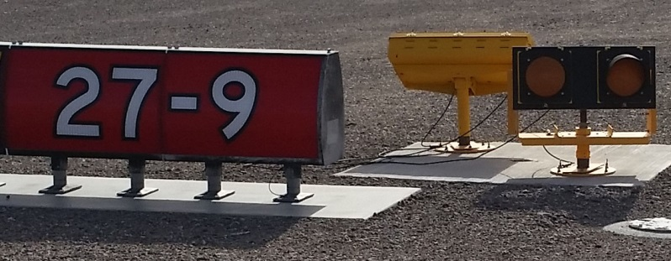

Runway Signs
Hold Short Signs
Red Background/White Lettering
Hold Short pavement markings
Double Solid Line – you cannot cross without an escort.

Slide 19
Taxiways - defined
A path on an airport connecting runways with ramps, hangars, terminals and other facilities.

Slide 20
Taxiway Layout
B
D
D
A
B

Slide 21
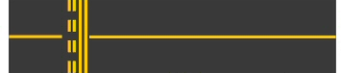
Taxiway - markings
Yellow
Runway Hold Short Markings
Taxiway Centerline

Slide 22
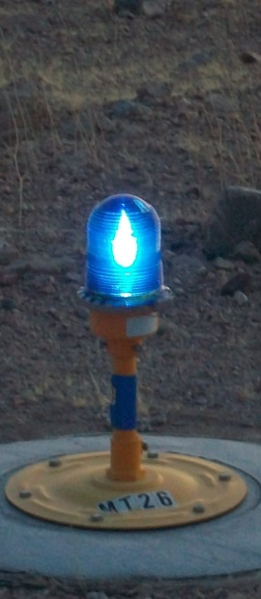
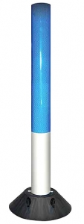
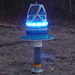
Taxiway - lighting
Blue taxiway edge light or reflectors

Slide 23
Taxiway - signage
Taxiways are phonetically pronounced as listed below, a full list of can be found in the Ground Vehicle Operations Manual.
B = Bravo
D = Delta
D = Delta
A = Alpha

Slide 24
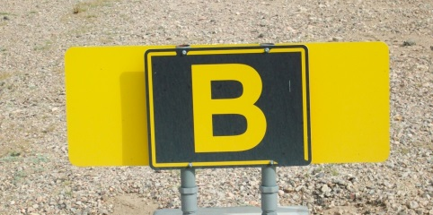
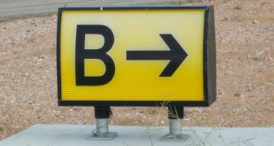
Taxiway - signage
Location Sign has a black background and yellow lettering
Directional…which taxiway you’re approaching and their direction.
Good way to remember is Black is where your at and yellow is where to go

Slide 25
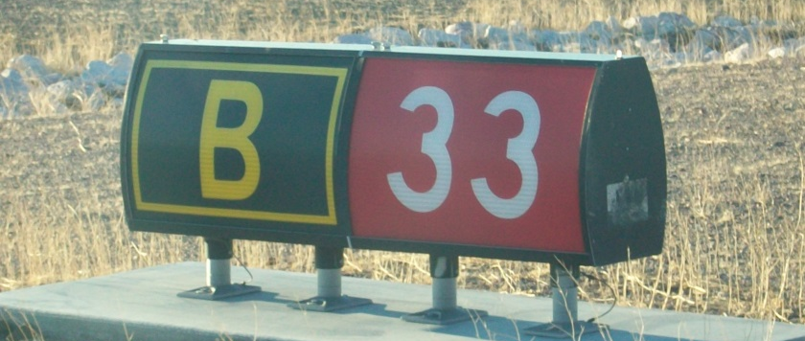
Taxiway - signage
Taxiway & Hold Short Sign – indicated you are approaching a runway and must stop at the sign and get an escort before proceeding out on the runway.

Slide 26
Hot Spot - Taxiway Delta
Taxiway Delta between Taxiway Alpha and Bravo is designated and airport Hot Spot:
A location with a history of potential risk of collision and where heightened attention by pilots and drivers is necessary.

Slide 27
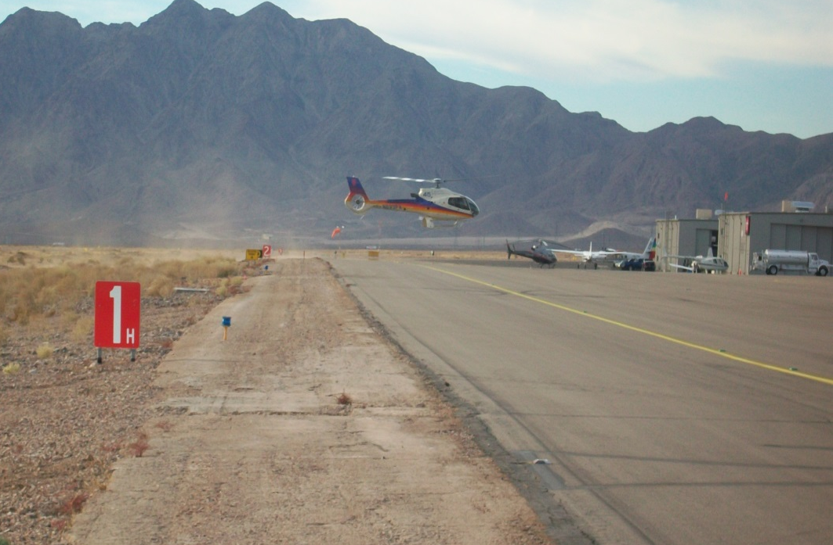
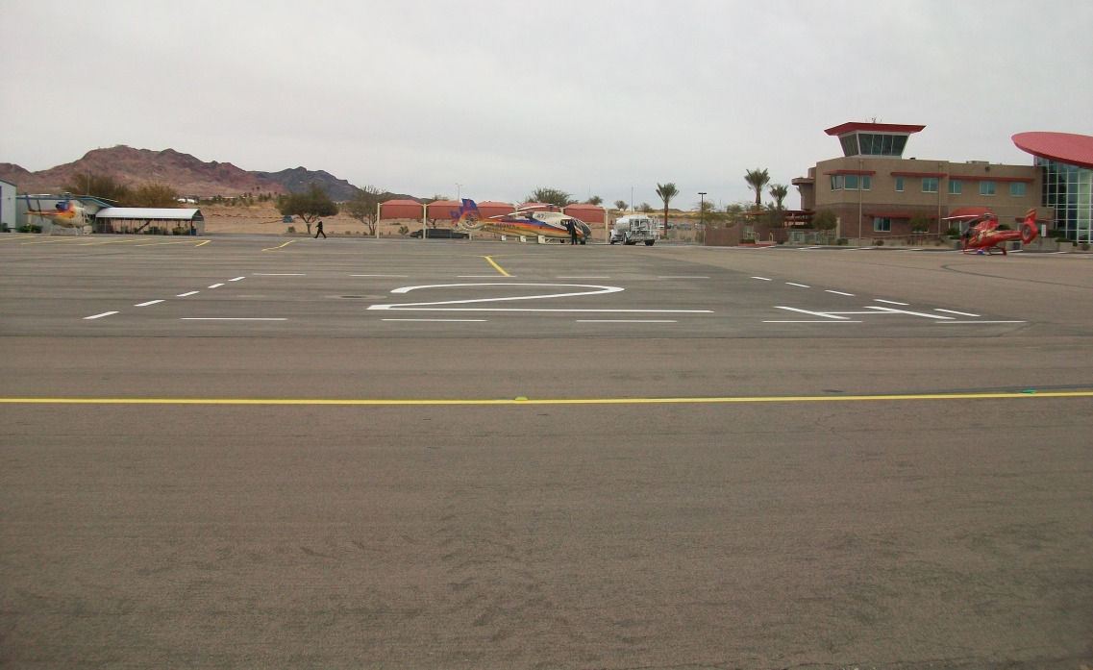
HOT SPOT
Helicopters cross Taxiway Delta very low to/from the FATOs or Heli Spot 1,2,3, 4
(Final Approach & Take-off Area)
USE EXTREME CAUTION
When traveling on Taxiway Delta
Stop

Slide 28
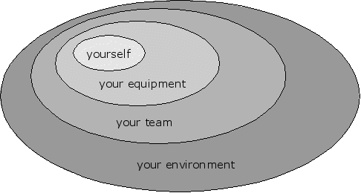
Situational Awareness
…is a perception of environmental elements with respect to time and space…it is how you understand information, event’s and how one’s actions will impact events– both immediately and in the future.
…maintain positive situational awareness when on the airfield – EVERYWHERE you go

Slide 29
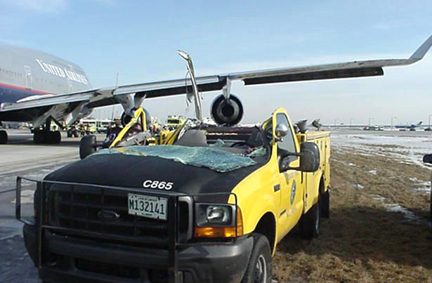

Situational Awareness Paramount to your Personal Safety

Slide 30
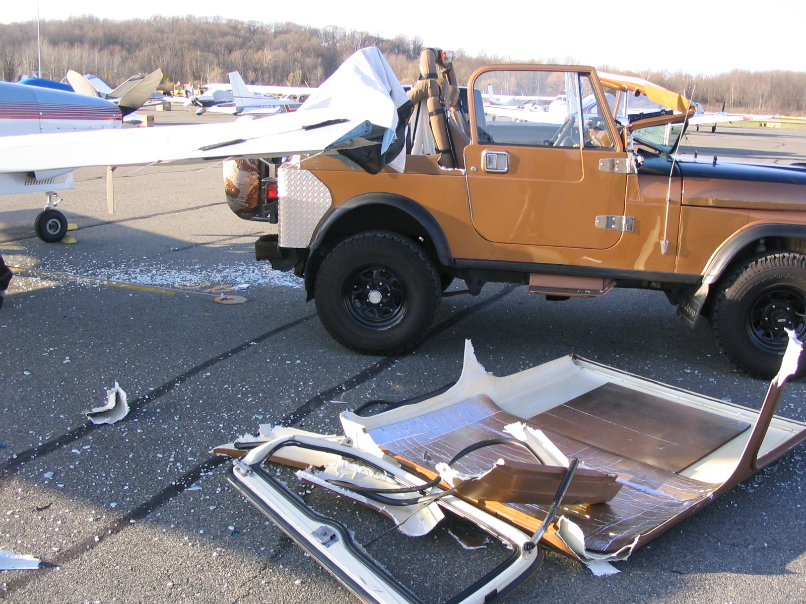
Situational Awareness Paramount to your Personal Safety

Slide 31
Who Can Drive in the AMA?
To Operate in the AMA you must:
Authorization by your supervisor AND
Approved by the Airport Management Office
Runway Access is Not Permitted
Escort by Airport Management Only to proceed on Runways

Slide 32
Vehicles in AMA
NO Privately Owned Vehicles
Authorized Vehicles ONLY
Authorized by Airport Management ONLY
Authorized Vehicles will have a permit sticker on the rear bumper
BVU
AMA
066

Slide 33
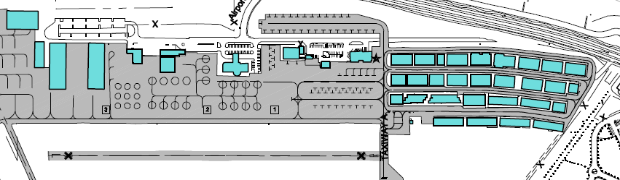
Access Gates
Gates are located around the airport and access to these gates are limited by the company you work for and the locations you operate from.
This will be reviewed at the time you receive your badge
Pedestrian Gate #4
Vehicle Gate #68
Vehicle Gate #8
Pedestrian Gate #16
Vehicle Gate #1

Slide 34

Airport Speed Limit
Airport Airside Speed Limit 10mph

Slide 35
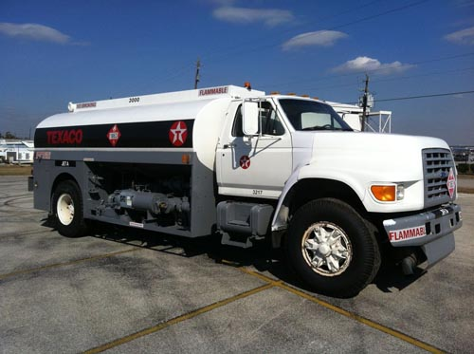
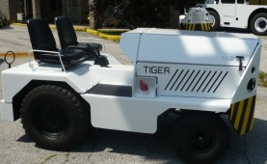
Vehicles
Commercial Vehicle
…any vehicle on airside used for the support of aircraft.

Slide 36

Vehicles
Privately Owned…any vehicle on airside used for purpose other than commercial or emergency
Permitted in the Hangar and North Tie Down Only
Example –pilot driving on the taxi-lane to access his or her aircraft.

Slide 37
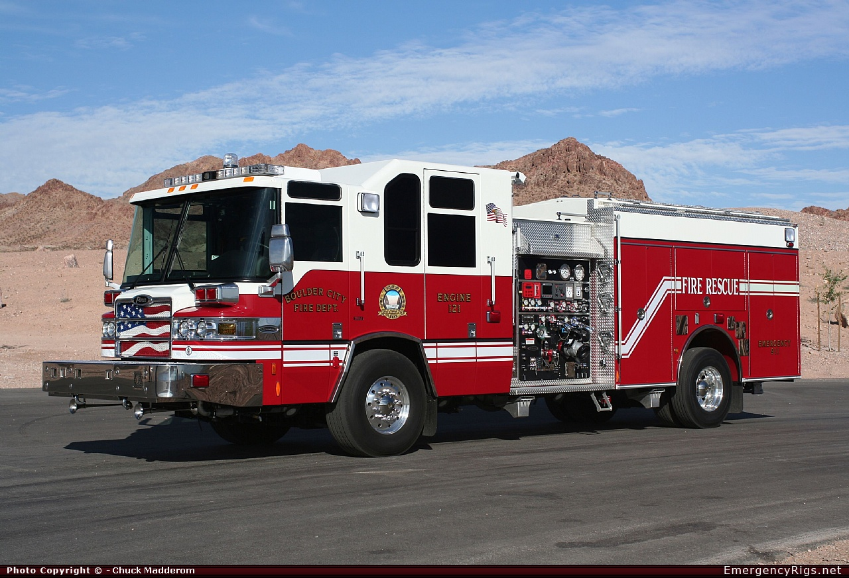
Vehicles
Emergency Vehicles…operated by local agencies to respond to an emergency situation.
Give way to emergency response vehicles.

Slide 38
Driving on the Airport
Ensure your Beacon and Radio are turned ON
Stop-Look-Listen for Aircraft
Small aircraft can blend in with the surroundings
Helicopters transition from many different locations
Monitor the Aircraft Radio for aircraft movements on UNICOM/CTAF 122.7
Aircraft Always have Right of Way

Slide 39
Unicom-CTAF Purpose Frequency 122.7 – Monitor at ALL TIMES
For collision avoidance
Communicate if you must, but keep it to a minimum as the radio is congested with aircraft announcing position reports
Speaking over the UNICOM/ CTAF
Listen for space to talk
Know exactly what you want to say before you say it…rehearse it in your head.
Be as concise as possible

Slide 40
Airfield Accidents
Accident – a collision between one aircraft or vehicle and another aircraft, vehicle, person, or object which results in property damage personal injury, or death.
Accidents are caused by:
human error,
unfamiliar with an airport, or
loss of situational awareness.

Slide 41


Vehicle Accidents
Vehicle Accident - If a vehicle accident occurs STOP and:
Remain at the scene of the accident
Immediately notify 911 and Airport Management.
If capable and it is safe to do so, assist those who are injured
Provide information to Airport Management or Police

Slide 42
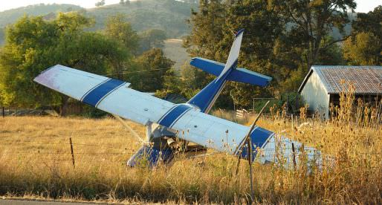
Aircraft Accident
Aircraft Accident can be an aircraft that crashed or has a flat tire, overrun, fire, etc, stalled.
Who to notify:
911
Airport Management – 702-293-9405
FBO – Boulder City Aviation Services - 702-638-3205
Aircraft must not be moved without prior permission from Airport Management.
Notes:
If

Slide 43
Airfield Accidents
Review
Call 911
No Matter the size it must be reported to Airport Management
Never move an aircraft until you have authorization from Airport Management
Stay and provide a statement to Police/Airport Management

Slide 44

Escorting Procedures
Provided to:
Vendors, Inventory/Supply Delivery, Contractor, Mechanic
Your Responsibilities:
Notify individual they are operating in the AMA
Make sure individual remains under your control
You are ultimately responsible for the person you are escorting!

Slide 45
Security
When operating on the Airport:
Airport Access Badge/Airport ID Visible
When you enter/leave the airport , watch the gate shut – completely.
Gates – broken or malfunctioning report
Dispatch 702-293-9224 after hours
Airport Staff 702-293-9405 7am-5pm

Slide 47
Violations
What is a violation?
Any observed or report of a person not following the rules set forth in the airports ground vehicle program.
Carless and reckless behavior on the airfield.
Penalties for violating a rule is:
Removal of driving privileges
Retraining
Fine of not more than $1000 (day 9-4-6 of the Boulder City Code )

Slide 48
Violations
Violation Process
Written Warning
1st Notice – Retraining within 30 days & $25 fee
2nd Notice – Suspended privileges for 30 days $ 25 fee
3rd Notice – Possible revocation of privileges
Airport Management reserves the right to immediately revoke the driving privileges of violators who cause an accident, incident or is careless/reckless on the airport.

Slide 49
Foreign Object Debris
FOD – is a substance, debris, or article which could potentially cause damage to an aircraft.
Common Types of FOD found at BVU:
Screws
Rocks, sand, dirt
Small tools
Trash; paper, cups, bottles, cans, cardboard, plastic bags, fast food wrappers, food, fruit peels, cigarette butts, etc.

Slide 50

FOD . . . Not Your Problem ? Think Again!!
Did you Know:
Misplaced tools and parts are the most common form of FOD. They cause damage, lost time, and lost productivity.
Items such as papers, bottles, cans, loose coins, plastic bags, personal devices, pencils, and pens can cause serious FOD damages

Slide 51
Foreign Object Debris
Potential hazard to all aircraft owners and tenants and passengers.
Creating:
Flight delays
Aircraft damage
Accident/Incident
Injury to ramp personnel

Slide 52
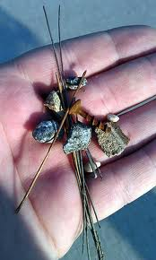
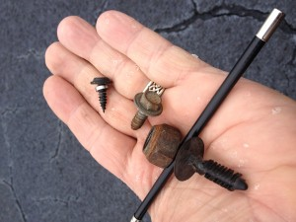
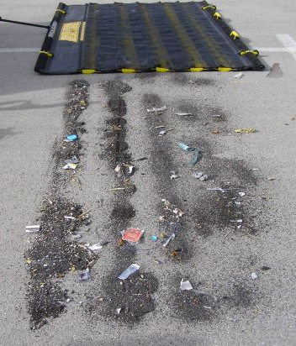
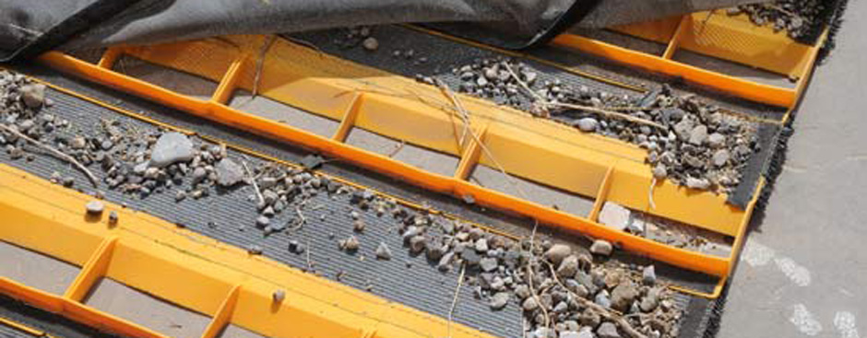
Foreign Object Debris
What does it look like?

Slide 53
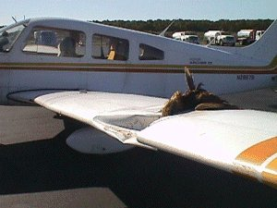
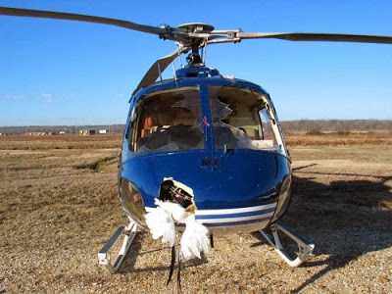
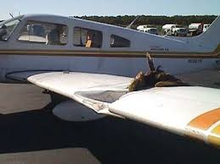
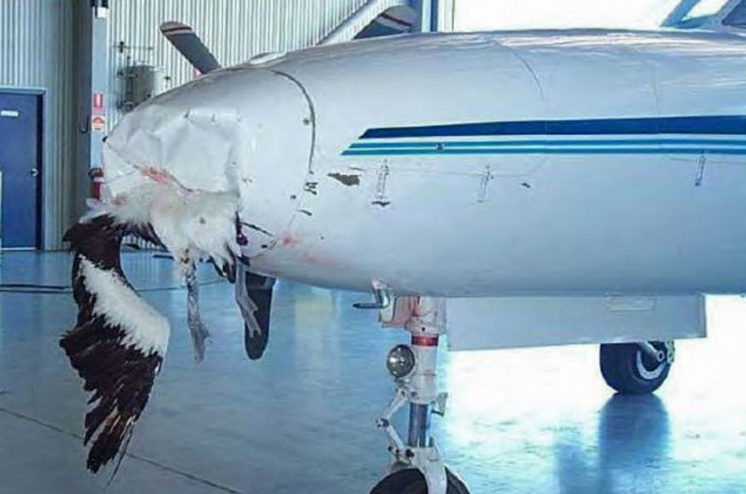
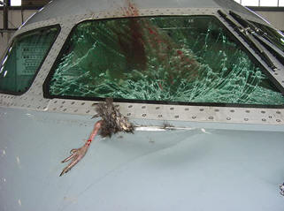
Foreign Object Debris
Littering Food Items can become a wildlife attractant.
Wildlife present on the airfield pose as another risk to aircraft: Wildlife Strike

Slide 54



Clean-As-You-Go
What does this mean?
During your normal daily routine pickup the out of place and unordinary items you find along the way.
Anything you see airside or landside – If you see garbage spilling out of the dumpster on a windy day this can become FOD across the airport.
Don’t think the next guy will get it…Take responsibility and help keep our airport FOD FREE.

Slide 55

Remember
Airport Access is a Privilege – Not a right.
Not for personal use.

Slide 56
Be sure to have reviewed the Ground Vehicle Operations Manual along with watching this presentation. Visit www.flybvu.com for a copy of the manual. Review the airfield layout as you will be asked questions regarding this on the test!! The test questions will be drawn from both resources. Visit the Airport Admiration Office for testing.
Review & Testing

